Slide 1
Impromptu
B09901008 電機三 蕭千玓
https://github.com/Hsiao-Chien-Ti/Impromptu

Slide 2
01.
Introduction

Slide 3
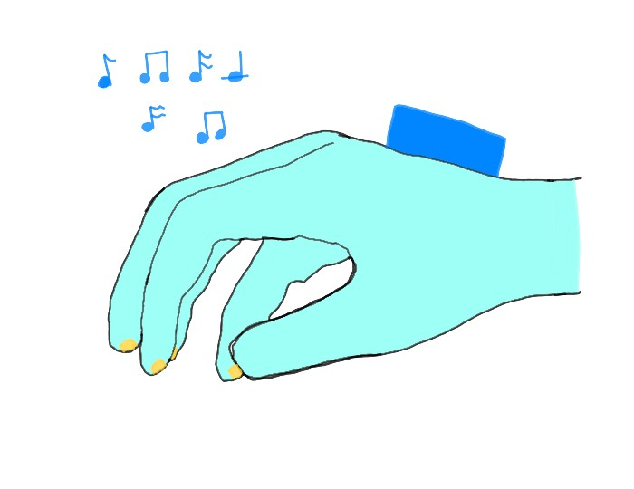
What is Impromptu(即興曲)?
隨處可彈的鋼琴手套
手勢偵測切換音高(可關閉功能)
WiFi連接手機
APP控制
支援錄音功能
樂譜功能

Slide 4
02.
Motivation

Slide 5
Why Impromptu?
Just for fun!
APP store Piano sucks!
Idea is everywhere!
Be quiet and noisy!
無聊就想動動手指
手指太粗好難按
靈感稍縱即逝趕快錄下來
戴上耳機怎麼彈都不吵到別人

Slide 6
03.
Methods

Slide 7
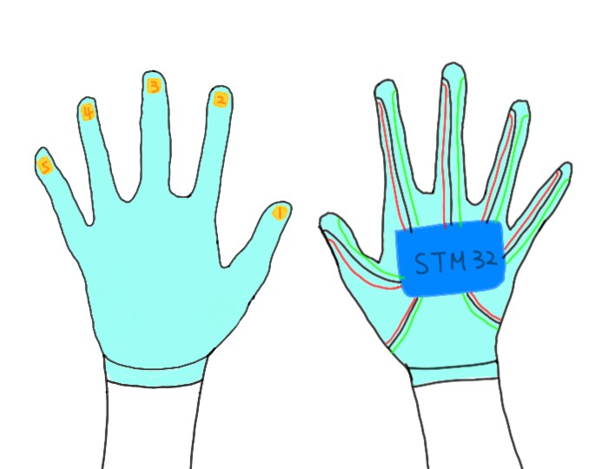
Design
WiFi
APP
Fingertips
Pitch Switching

Slide 8
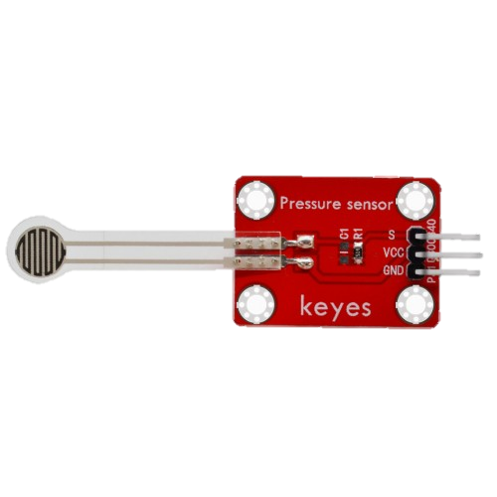
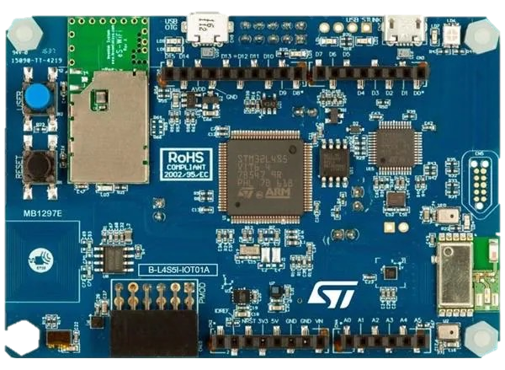
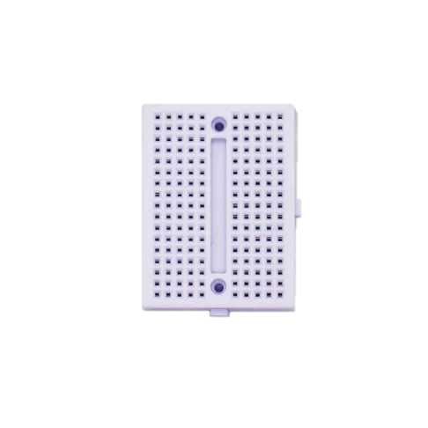

Components
STM32-L4S5I
Keyes薄膜壓力感測器
迷你麵包板
棉質手套

Slide 9
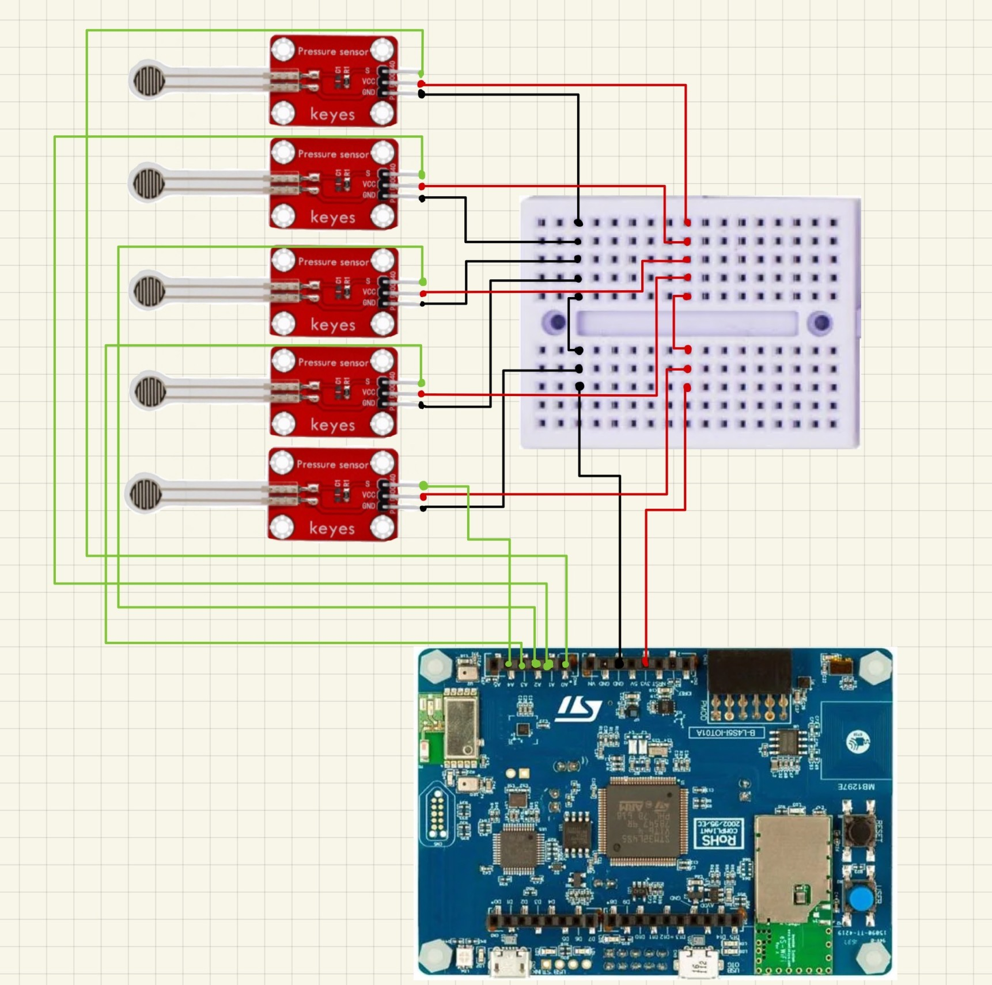
Circuit Design

Slide 10
Socket Programming
Server: Cellphone
Client: STM32

Slide 11
Finger Tip Press
Keyes薄膜壓力感測器
AnalogIn read_u16()
Threshold: 14000
和threshold比大小後傳送0/1給server

Slide 12
Pitch Switching
STM32加速度感測器
DSP FIR lowpass filter
Threshold:-30, 30
-
+
+
-
音高--
音高++

Slide 13
APP
Android Studio Kotlin
4 Fragments: Navigation
SocketHandler, SettingVariable: Object, Thread, Volatile
Socket Programming: ServerSocket
播放音樂：SoundPool
錄音功能：MediaRecorder (需要權限)
範例樂譜：RecyclerView
設定：Switch component

Slide 14
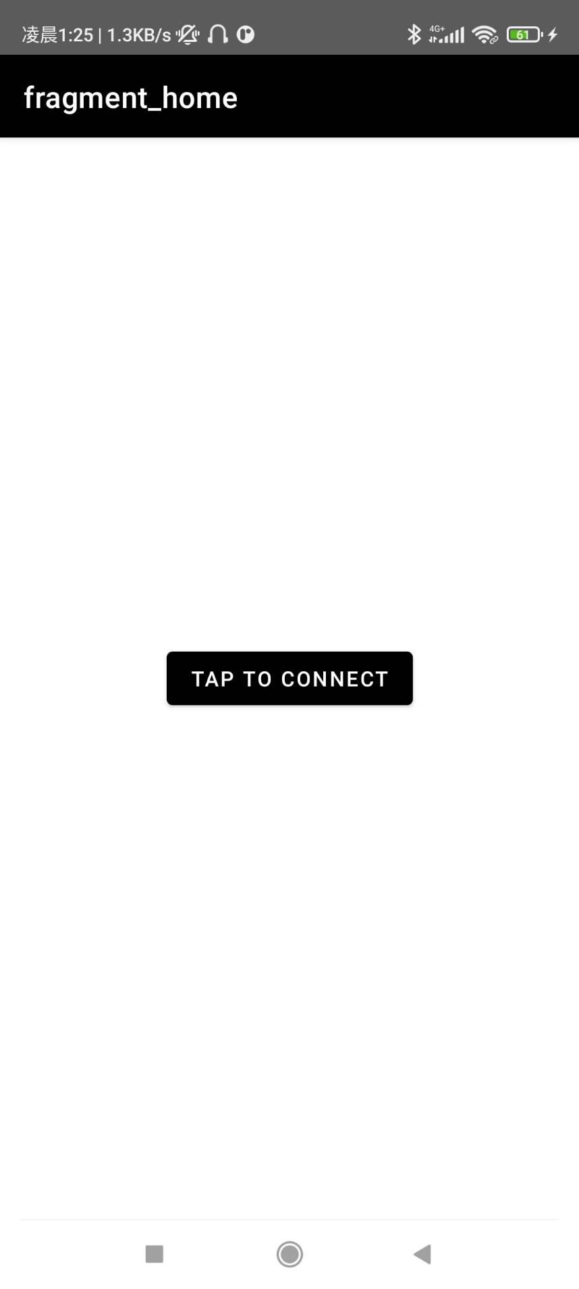
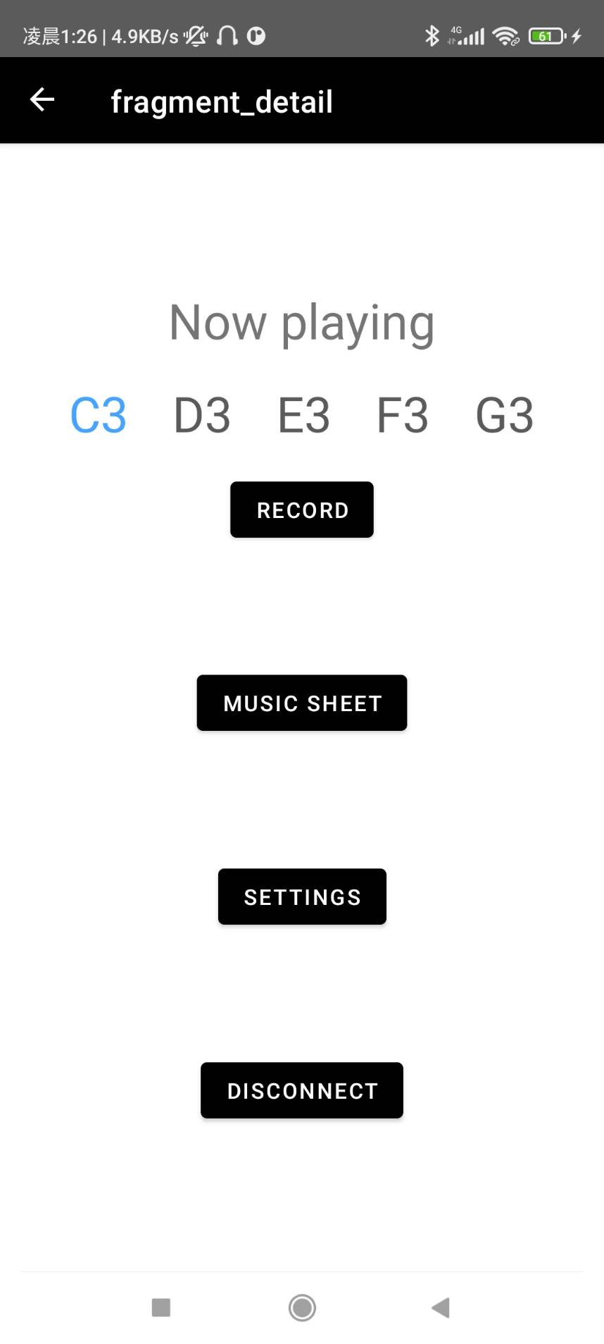
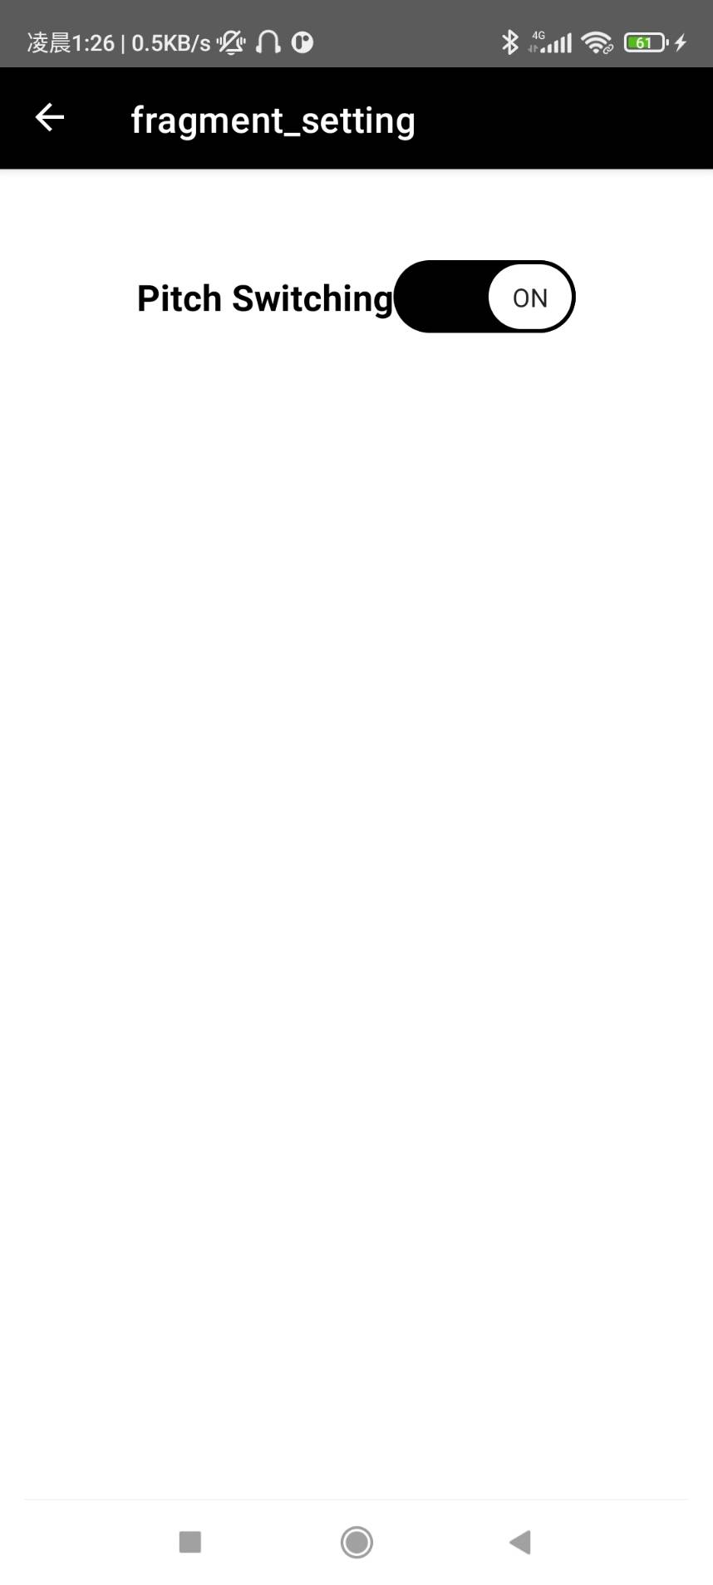
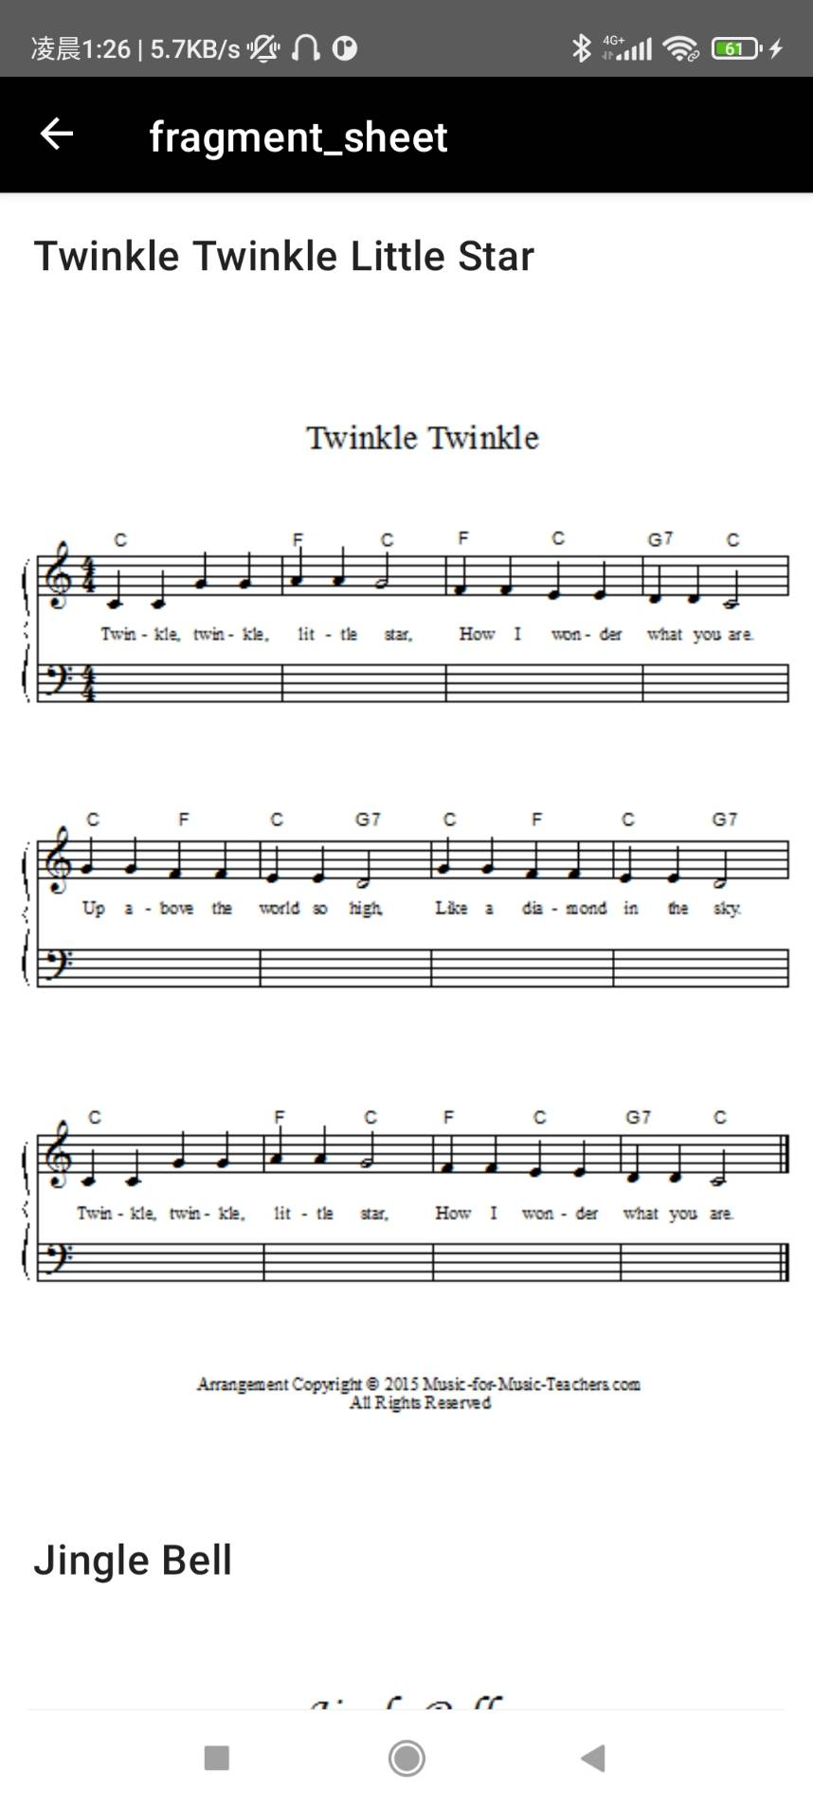

Slide 15
04.
Demo Video

Slide 16
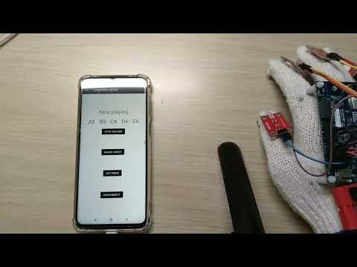

https://youtu.be/yZZKF2OYE3M

Slide 17
05.
References

Slide 18
REFERENCES
1. Android studio: https://developer.android.com/courses/android-basics-kotlin/course?authuser=3
2. MbedOS: hw2, hw7
3. Previous work: https://www.amazon.com/Electric-Piano-Gloves-Playable-Interactive/dp/B00PTMORKS

